Slide 1
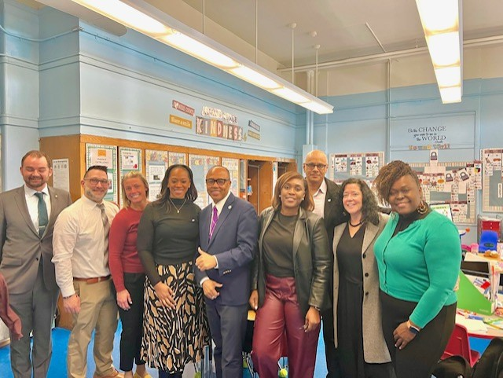
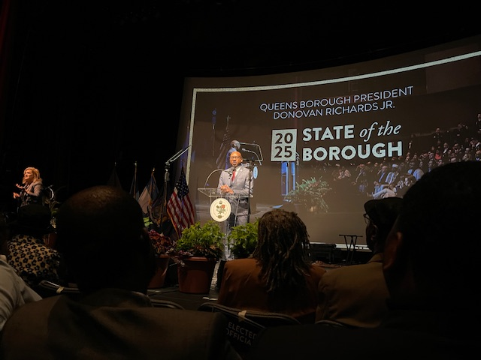

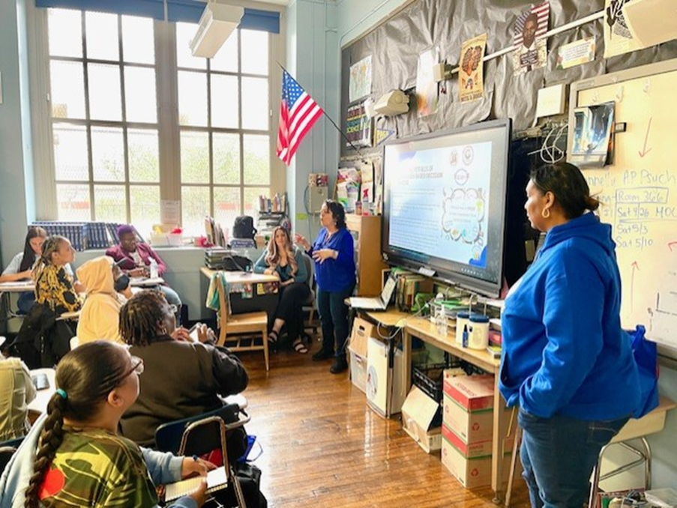
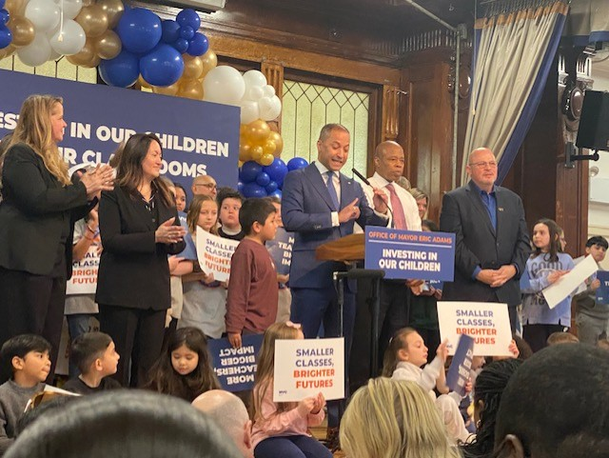
Literacy Proficiency
Math Proficiency
Chronic Absenteeism & Retention
Parent Engagement
Community
Superintendent
Dr. Eric L. Blake
May 1, 2025
Deputy Superintendent
Dr. Shonelle Hall
“With effort and support all schools can meet the needs of their students and help them achieve outstanding educational outcomes”

Slide 2
District 28 Vision, Mission & Goals
The United Nations' mission statement includes the line, "In this noble undertaking, cooperation, collaboration, unity, and solidarity must be the light we should seek and follow. We commit to strive for inestimable contribution to human progress."
Mission
In Community School District 28 we focus on equity as a lever for achievement for every single scholar. We are a district of excellence. We commit to every school maintaining high academic standards and working closely with families so that all scholars are learning at high levels. Beginning with school leaders, teachers, students and community partners, we also commit to being a district of learners ensuring that we promote critical thinking rooted in core content conceptual understanding through creative problem solving, technology innovation, social emotional learning and community advocacy.
Vision
In Community School District 28 we celebrate our differences because we understand that woven into those differences is the knowledge that they offer us unlimited possibility to learn and expand our knowledge of and commitment to all humanity. We are beautifully diverse, varied; coming from countless racial, ethnic, language, and belief backgrounds. We commit to striving for inestimable contribution to the lives of our scholars.

Slide 3
D28 Mathematics Update
NYS Solves: The goal is to ensure that all New York City students develop math skills, a critical requirement for educational, career, and lifetime success. Based on extensive research, NYC Solves will ensure that students use high-quality curricula taught by well-trained and coached teachers.
Rollout of NYCPS Shifts in Mathematics
Ongoing Professional Development with school introducing and supporting the 5 shifts
Beginning with sensemaking
Shared Low – Floor - High – Ceiling
Discourse to develop understanding
Asset – based support
Shared High Quality Instructional Materials (HQIM)

Slide 4
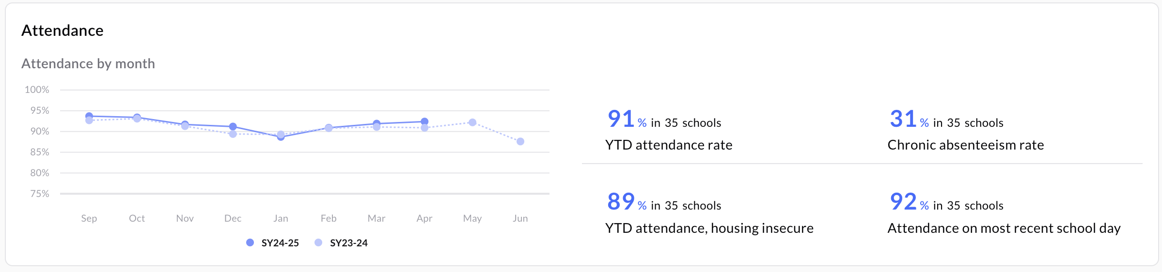
D28 Attendance Snapshot - As of 4/30/25
DCEP - Attendance Goals​​
By June 2025, we will increase district-wide attendance by 2 percentage points from 90.7% to 92.7% excluding students who are long-term international travelers.​​
By June 2025, we will reduce overall chronic absenteeism by 10% of overall Chronically Absent Students EOY 23/24 from 35% to 31%, excluding students who are long-term international travelers.​​
Where are we Now: April 30, 2025​​
YTD Overall Attendance: 92.4% vs 90.0% Citywide​​
Chronic Absenteeism YTD: 31% vs 34.8% SAME DATE LAST YEAR, representing an overall decrease​
The Data represented below shows D28 attendance improving monthly compared to last school year.
​

Slide 5
District 28: Class Size Reduction Recipients
New York City public schools are implementing a State-mandated class size reduction plan, aiming for full compliance by September 2028, phasing in schools each year.
The plan requires kindergarten through third grade classes to have no more than 20 students, grades 4-8 no more than 23, and high school classes no more than 25.
D28 has received funding allocations for approximately 119 new teachers and 4 AP's across the district for our approved schools.

Slide 6

NYS State Testing - Underway
State testing is underway, and our district is proud to support every school throughout this important time. Parents, let's rally behind our amazing students—encouraging them to stay positive, focused, and to do their very best. We believe in their potential and know they’re capable of achieving great things!🌟
NY State Mathematics Assessment Grades 3-5
NY State Ela Assessments Grades 3-5
NYSESLAT – all English Language Learners (ELL) Students K - 12

Slide 7
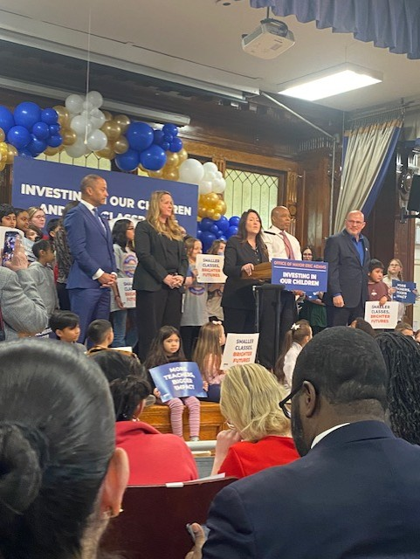
NYC READS/ NYC SOLVES ANNOUNCEMENT
New York City Mayor Eric Adams and New York City Public Schools Chancellor Melissa Aviles-Ramos have expanded NYC Reads and NYC Solves to 186 additional schools across 14 districts, expanding high-quality, evidence-based foundational reading and math curricula to middle school students across the five boroughs. With this expansion, over 490,000 students will benefit from NYC Reads and NYC Solves by the 2025-2026 school year.

Slide 8
Congratulations! 2025 Respect For All (RFA) Schools
This recognition highlights these schools' dedication to creating and maintaining safe and supportive learning environments, free from discrimination, harassment, intimidation, and bullying. Our goal is to have all D28 schools on this list.
​
P.S. 055 Maure
P.S. 040 Samuel Huntington
P.S. 054 Hillside
P.S. 139 Rego Park
P.S. 160 Walter Francis Bishop
P.S. 121 Queens
P.S. 196 Grand Central Parkway

Slide 9
Summer Rising
Summer Rising applications are now OPEN
2024-2025 Summer Rising Admissions Dates: The following is a timeline to help you keep track of all important dates for the upcoming Summer Rising Admissions process.
April 24 – Summer Rising Results
May 8 – Acceptance Deadline
Students who have not received a seat will be placed on a waitlist. If a seat becomes available,
the school will send offers to families based on the order in which they are placed on the waitlist.
Learn more about admissions updates and the Summer Rising Application at nyc.gov/summerrising
MySchools for families: MySchools.nyc

Slide 10
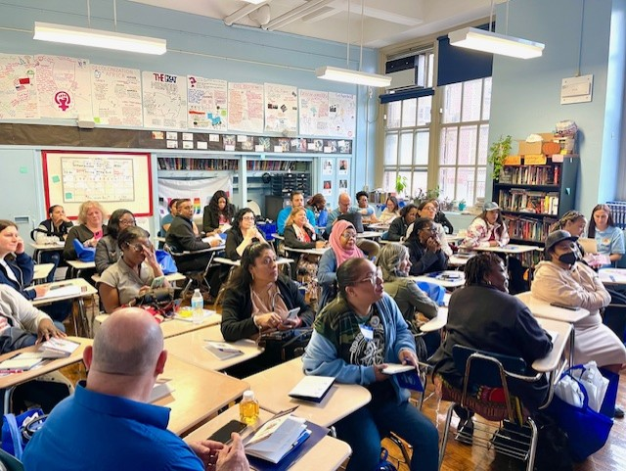

2025 Citywide Conference for School and District Leadership Teams
We had a very successful conference. The focus was on the achievement of NYCPS’s mission to ensure that each student graduates on a pathway to a rewarding career and long-term economic security, equipped to be a positive force for change.
A huge thank you to our very own Sonia Rueda, Shirley Aubin, Randi Garay for hosting a very informative workshop on empowering and elevating SLT and DLT voices.

Slide 11
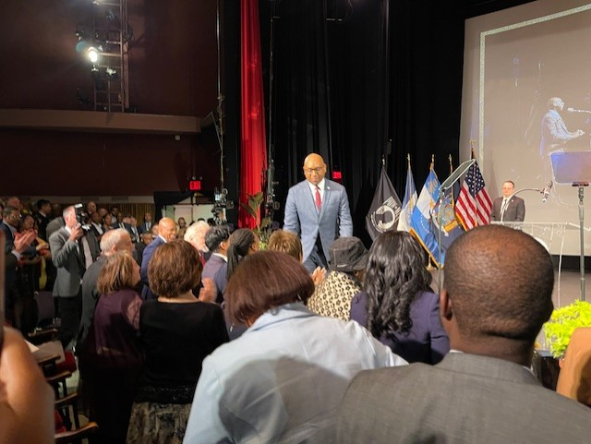
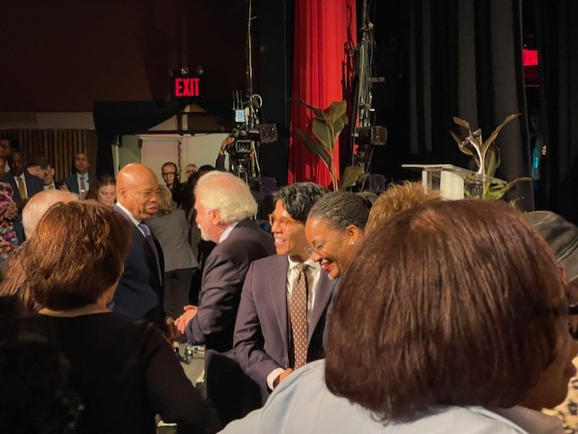
QBP’s State of the Borough
Queens Borough President Donovan Richards announced significant investments in his State of the Borough address, focusing on affordable housing, economic development, and public safety. He emphasized the importance of community engagement and collaboration to achieve these goals. He also highlighted plans to improve infrastructure and green spaces across the borough. On behalf of the D28 school community, we extend our heartfelt thanks to Borough President Richards and his team for his unwavering dedication to District 28 and the Queens community.

